Slide 1

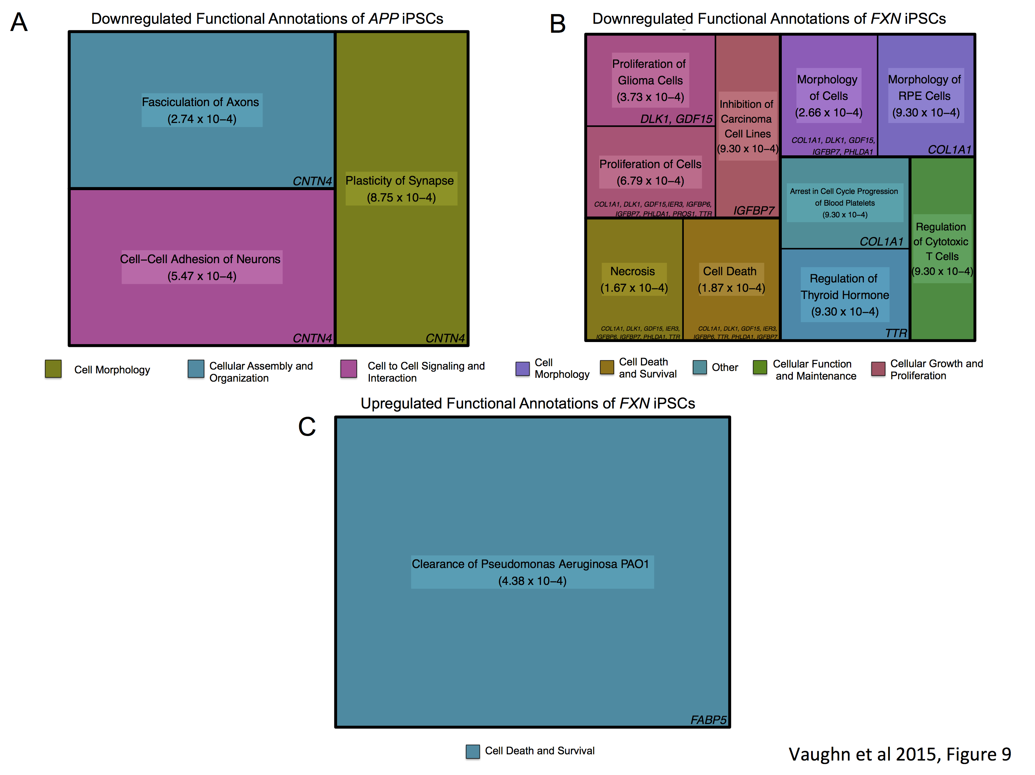
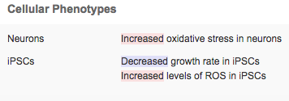
Input
iPheMap
Output
Phenotypic and Genetic Expression Profiles
Searchable Database
Cellular Phenotypes
Molecular Phenotypes
Dysregulated Pathways
iPheMap comprises a comprehensive catalog of phenogenetic profiles from patient derived-iPSCs from highly curated, published reports and returns:
Cellular phenotypes reporting morphological, functional, and process changes from iPSCs, NSCs, oligodendrocytes, astrocytes, and neurons with genetic mutations linked to neurological diseases.
Molecular phenotypes, which stem from the microarray analysis, are derived from the functional annotations associated with previously established genome ontology. These molecular phenotypes are presented as treemaps, sized according to their degree of statistical significance.
Dysregulated pathways also arising from genome ontology, which reflect disrupted canonical pathways.

